Slide 1
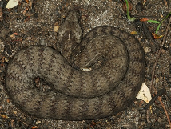
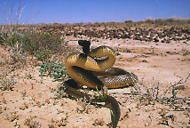
snakes
Venomous and Non-venomous

Slide 2
Part 1

Slide 3
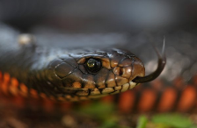
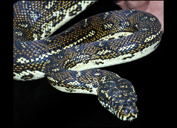
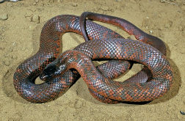
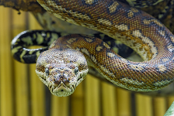
Some Facts about snakes:
Snakes are found on every continent except Antarctica
Snakes have no eyelids
Snakes can lay eggs and some can give birth to live young
Most snakes are immune to their own venom
Australia has around 140 species of land snakes, and 32 recorded species of sea snakes

Slide 4
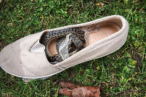
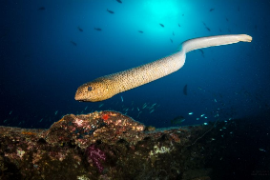
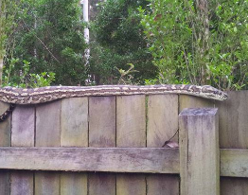
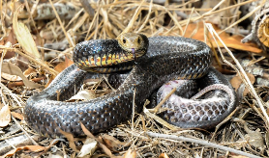
habitat:
Their natural habitat is in water, trees and the bush; however, they can be found almost anywhere, including the backyards, in your pipes, and even in people’s shoes.

Slide 5
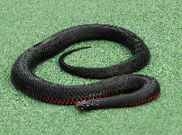
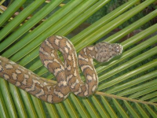
Venomous and Non-Venomous
Venomous snakes have sharp, hollow fangs that contain venom, and some of the most dangerous snakes can be found in Australia.
Non-venomous snakes do not have the same fangs and venom that poisonous. This group of snakes many live near the water and in trees.
Venomous: Red-bellied black snake
Non-venomous: Carpet python

Slide 6
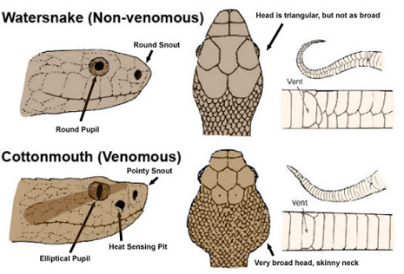
How can I recognise a venomous snake?
It is very difficult to tell the differences between a venomous and non-venomous snake. To be on the safe side, always presume the snake is venomous.

Slide 7
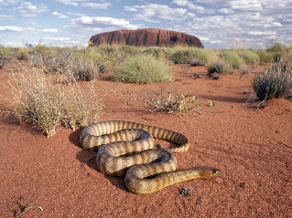
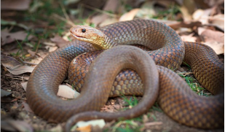
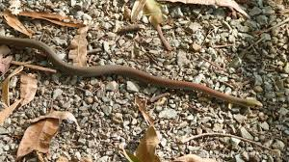
WILL A SNAKE CHASE me?
A snake will never bite a person for no reason, nor do snakes chase people just to bite them. The majority of snake bites in Australia happen because someone decided not to leave a snake alone.

Slide 8
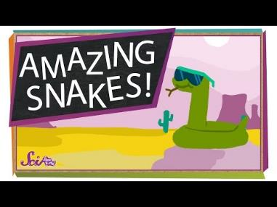
Now, here is a task
Watch this video. Record facts about snakes by drawing or writing about what you have learned.
https://www.youtube.com/watch?v=BKH1TZ87Z1Q&feature=emb_logo

Slide 9
Part 2

Slide 10
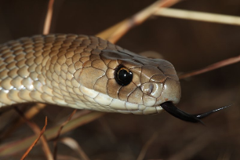
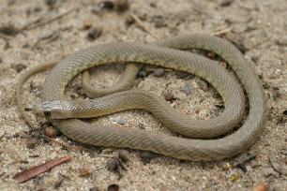
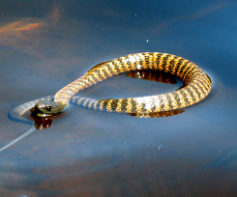
Australia’s 10 most dangerous snakes
1.Eastern brown snake
2.Western brown snake
3. Tiger snake

Slide 11
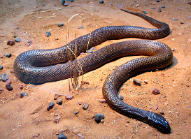
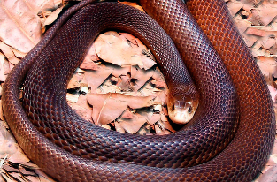
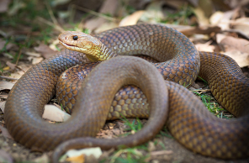
Australia’s 10 most dangerous snakes
4.Inland taipan
5.Coastal taipan
6. Mulga snake

Slide 12
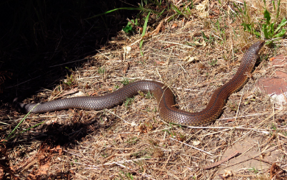
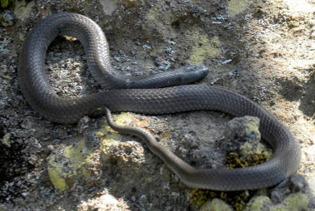
Australia’s 10 most dangerous snakes
7.Lowland copperhead
8.Small-eyed snake

Slide 13
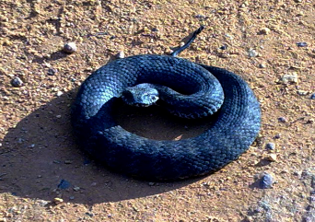
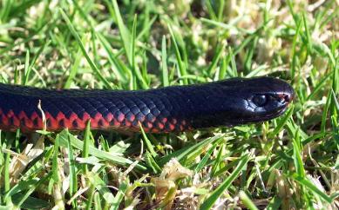
Australia’s 10 most dangerous snakes
9.Common death adder
10.Red-bellied black snake

Slide 14
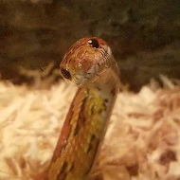
What to do if I see a snake?
Remain calm!
Stay still, don’t panic, try to move slowly away, and ask an adult for help.
When walking in the bush, avoid open-toed shoes and wear long pants.
If you are bitten it is important to stay calm, don’t try and capture the snake, call 000.
Oh hello

Slide 15
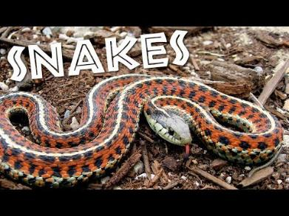
Now, here is a task
Watch this video. Record facts about snakes by drawing or writing about what you have learned.
https://www.youtube.com/watch?v=BOHFt15eVD4&feature=emb_logo

Slide 16
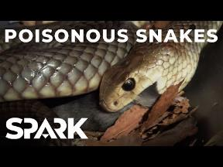
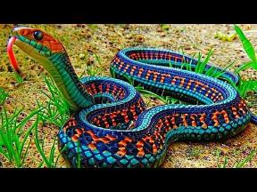
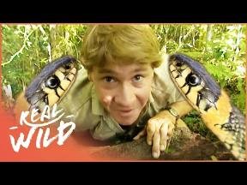
Videos
Want to learn more about snakes? Here are some videos:
https://www.youtube.com/watch?v=blfS5jfG-Dc&feature=emb_logo
https://www.youtube.com/watch?v=4Chgih5FqSE&feature=emb_logo
https://www.youtube.com/watch?v=GA0L9Wio-IY&feature=emb_logo

Slide 17
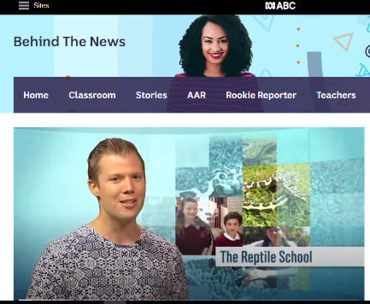
Bonus:
Behind the News - Reptile school https://www.abc.net.au/btn/classroom/reptile-school/10525580

Slide 18
References:
https://www.environment.nsw.gov.au/topics/animals-and-plants/native-animals/native-animal-facts/snakes
https://www.australiangeographic.com.au/topics/wildlife/2016/02/everything-you-need-to-know-about-snakes/
https://www.australiangeographic.com.au/topics/wildlife/2016/02/everything-you-need-to-know-about-snakes/
https://www.australiangeographic.com.au/topics/wildlife/2016/02/everything-you-need-to-know-about-snakes/
http://www.whatsnakeisthat.com.au/category/region/victoria/port-phillip/
https://study.com/academy/lesson/australian-snakes-facts-lesson-for-kids.html

