Slide 1
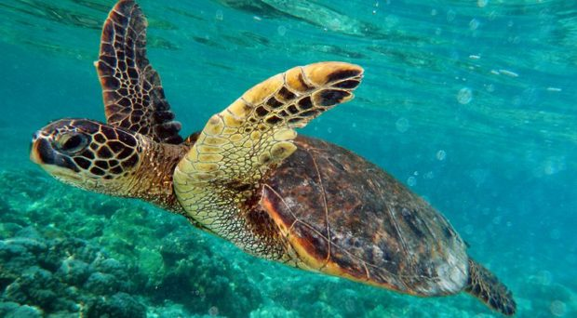
Australian Marine Turtles
All about Marine Turtles and their Habitat

Slide 2
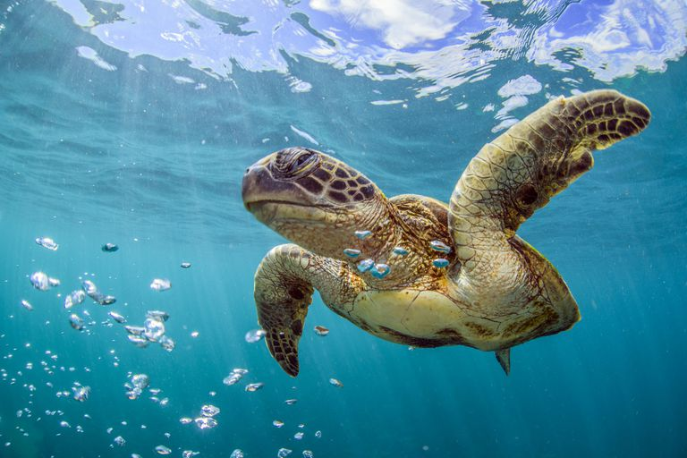
What are Marine Turtles?
Turtles are reptiles. Marine means that they live in the ocean.
Reptiles rely on their environment to control their body temperature – so if they are cold, they will have to move to somewhere warmer to warm up. If they are too warm, they will need to move to somewhere cooler.
Reptiles have a backbone (they are called vertebrates), have scaly skin, and breathe using lungs. This means that turtles need to come up to the surface of the water to breathe.
Turtles, like most reptiles, lay eggs on the land.
Marine turtles have lived in the oceans for over 100 million years, they were around when the dinosaurs roamed on the Earth!
Marine turtles have a large shell (called a carapace), four strong paddle-like flippers, and a beak-like mouth.
They drink seawater and get rid of the salt by using special salt-glands in their eyes.

Slide 3
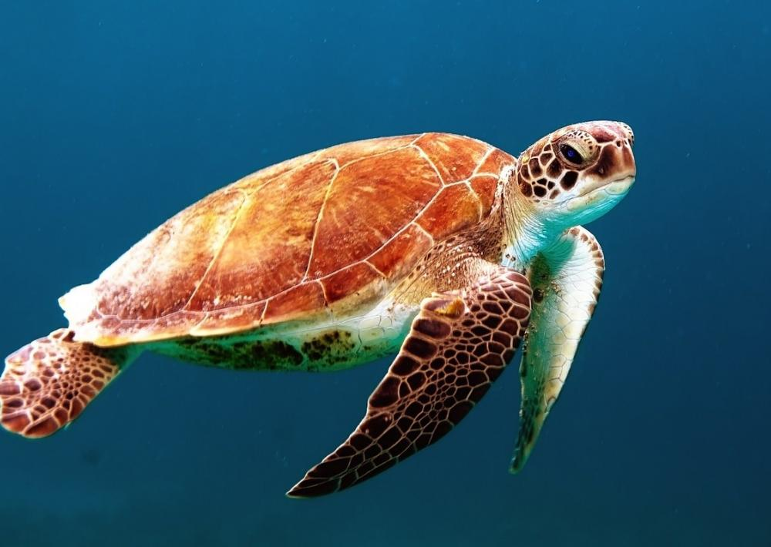
What types of Marine Turtles live in Australia?
Australia is home to six of the world’s seven species of marine turtle:
Green Turtle
Hawksbill Turtle
Leatherback Turtle
Loggerhead Turtle
Olive Ridley Turtle
Flatback Turtle
All of these species are are classified as either ‘vulnerable’ or ‘endangered’

Slide 4
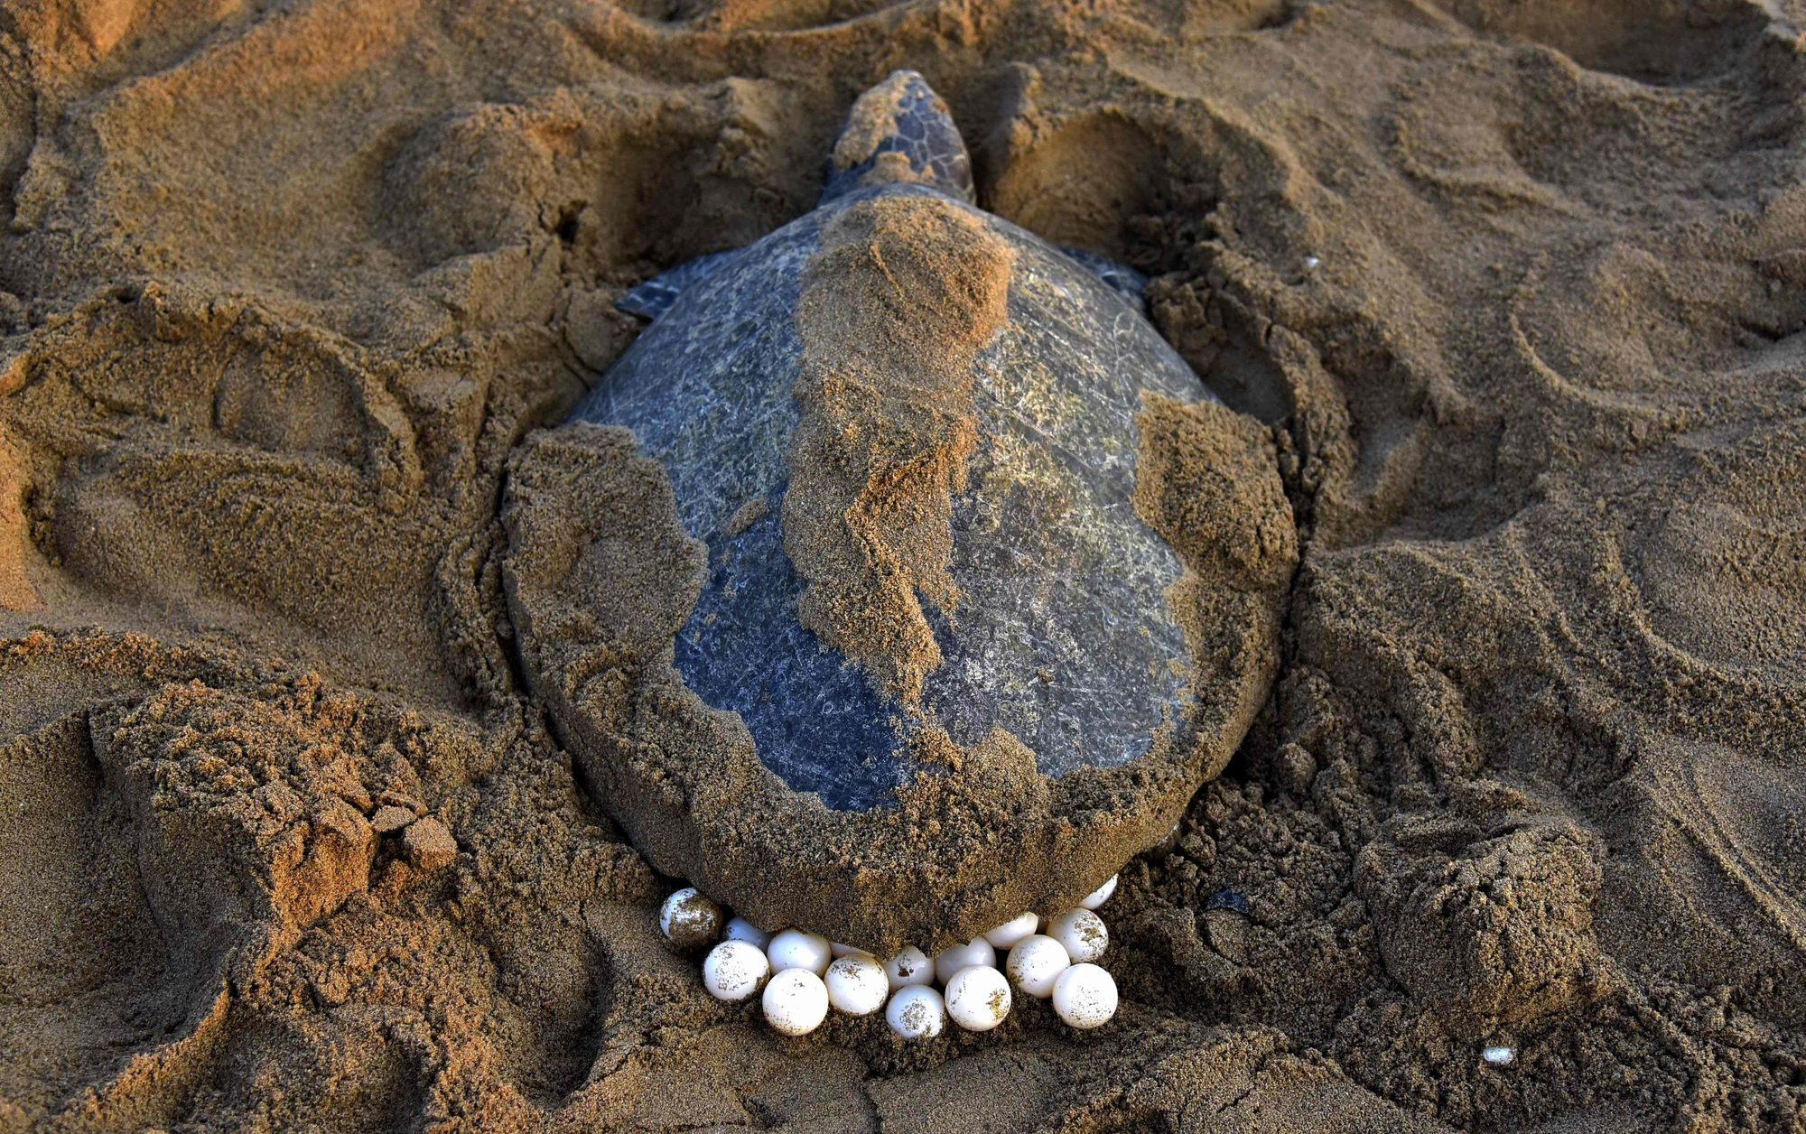
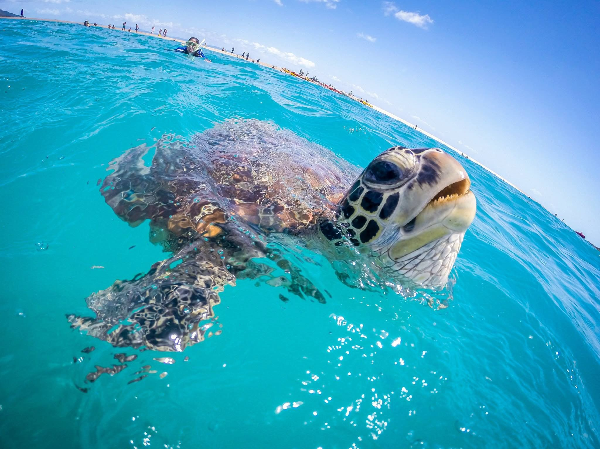
What do they need to survive?
They need to be able to come to the surface to breathe
Because they are reptiles, they need the ocean temperature to be suitable for them. If the ocean gets too hot or too cold, they may not survive.
They need a safe place to lay their eggs.
The temperature of the nest where they lay their eggs affects if their hatchlings will be female or male. Warm sand usually produces females, whilst cool sand produces males. This is important, because if all the turtles had mostly all male hatchlings, or mostly all female hatchlings, it would be very difficult for those turtles to create a new generation.
They need food to eat. Loggerheads feed mainly on fish and hard-shelled animals such as lobsters. Green turtles only eat plants like sea grasses, whilst leatherbacks eat mostly jellyfish.
They need to be able to drink seawater.
Their habitats need to provide these things for marine turtles to survive.

Slide 5
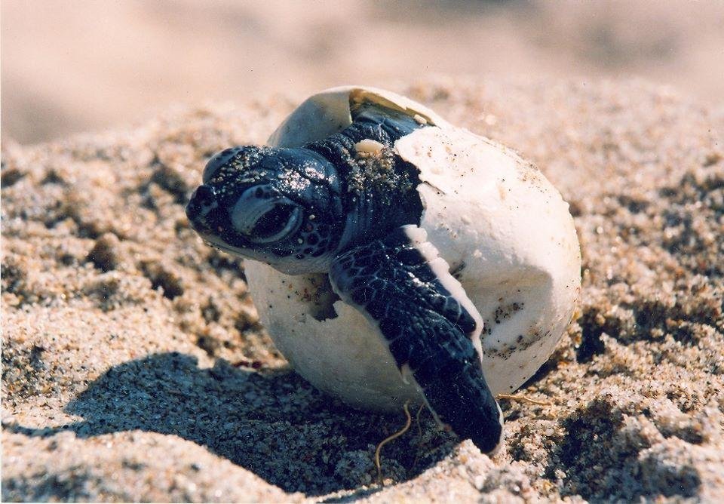
Marine Turtle Habitats
Marine turtles mostly live in the north of Australia.
They spend most of their time in the ocean. They are born on sandy beaches then move into the ocean. Female marine turtles come back to the sandy beaches to lay their eggs.
In the ocean they live in many different habitats. These include coral reefs, seagrass beds and mangrove forests.

Slide 6
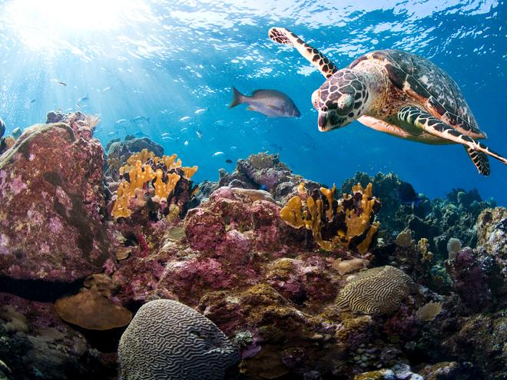
Coral Reefs
Coral reefs are large platforms of minerals. They are formed by coral polyps which are tiny animals.
Coral reefs provide shelter for many plants and animals.
The Great Barrier Reef has been growing for 500,000 years and is large enough to be seen from space.
Rising sea temperatures affect coral reefs because the coral dies when the sea gets too warm.
Learn more about coral reefs here:
https://www.youtube.com/watch?v=ZiULxLLP32s

Slide 7
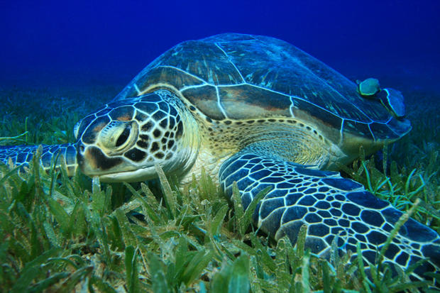
Seagrass Beds
A seagrass bed is a habitat that you can usually find alongside coral reefs.
Seagrasses grow in the sand.
They are bright sunlit fields of waving green underwater grass.
Learn more about seagrass beds here: https://www.youtube.com/watch?v=uRnFLujT368

Slide 8
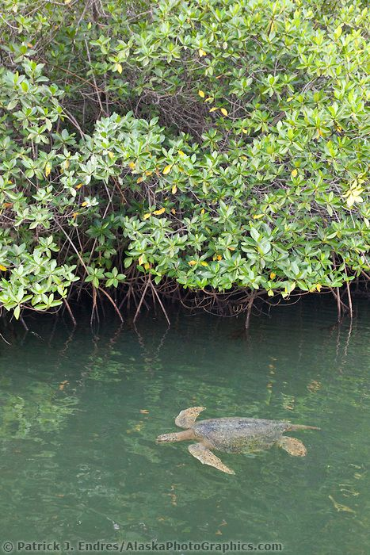
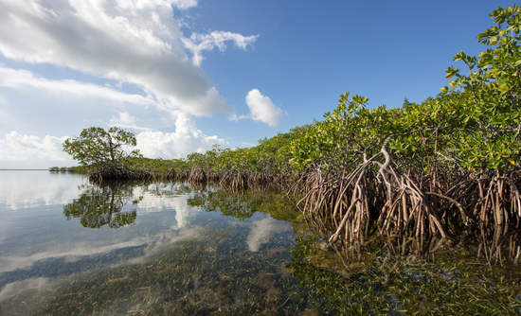
Mangrove Forests
Mangroves are trees that live along tropical coastlines
They grow in the salty seawater, as you can see in these photos
Mangrove forests provide a sheltered habitat for many different species
Learn more about mangrove forests here: https://www.youtube.com/watch?v=cwTZhyA57mA

Slide 9
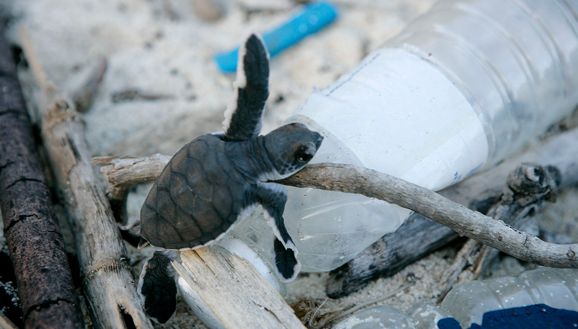
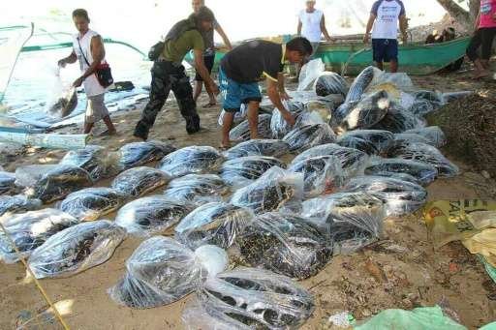
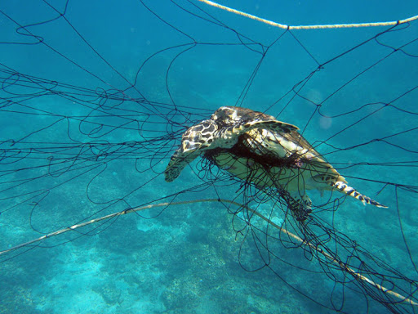
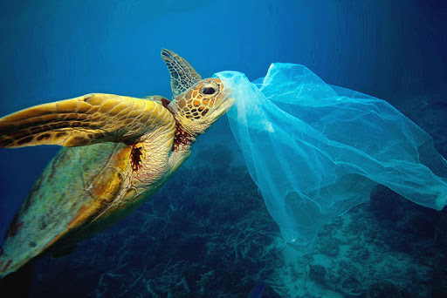
Why are Marine Turtles endangered?
Pollution, many turtles die from getting caught in rubbish or from eating rubbish thinking it is food.
Human activity along the coast – making it hard for them to lay their eggs safely
Fishing: getting caught in nets
People catching and killing turtles or taking their eggs
Animals such as foxes eating the eggs or the hatchlings
Climate change. The oceans and our earth are getting warmer and this is affecting the turtles’ habitats.

Slide 10
More information
https://www.youtube.com/watch?v=5Rmv3nliwCs
https://www.youtube.com/watch?v=t-KmQ6pGxg4
https://www.youtube.com/watch?v=zE0qp3Yje6Q
https://www.youtube.com/watch?v=E_e5dznx0kw
https://www.youtube.com/watch?v=gbhlJ_M0mYU

Slide 11
Your task
Draw or write about something new you learnt about Marine Turtles, or, draw a turtle in one of the habitats
.

Slide 12
Information sources
https://www.environment.gov.au/marine/marine-species/marine-turtles
https://www.aims.gov.au/species-at-risk/marine-turtles
https://wwf.panda.org/knowledge_hub/endangered_species/marine_turtles/
https://oceana.org/marine-life/marine-science-and-ecosystems/mangrove-forest
https://www.dcnanature.org/nature/ecosystems/seagrass-beds/

