Slide 1
Creature Clues
By F1S & F1A

Slide 2
Choose one of the following pages and read the clues.
As you read, visualise and draw the creature.

Slide 3
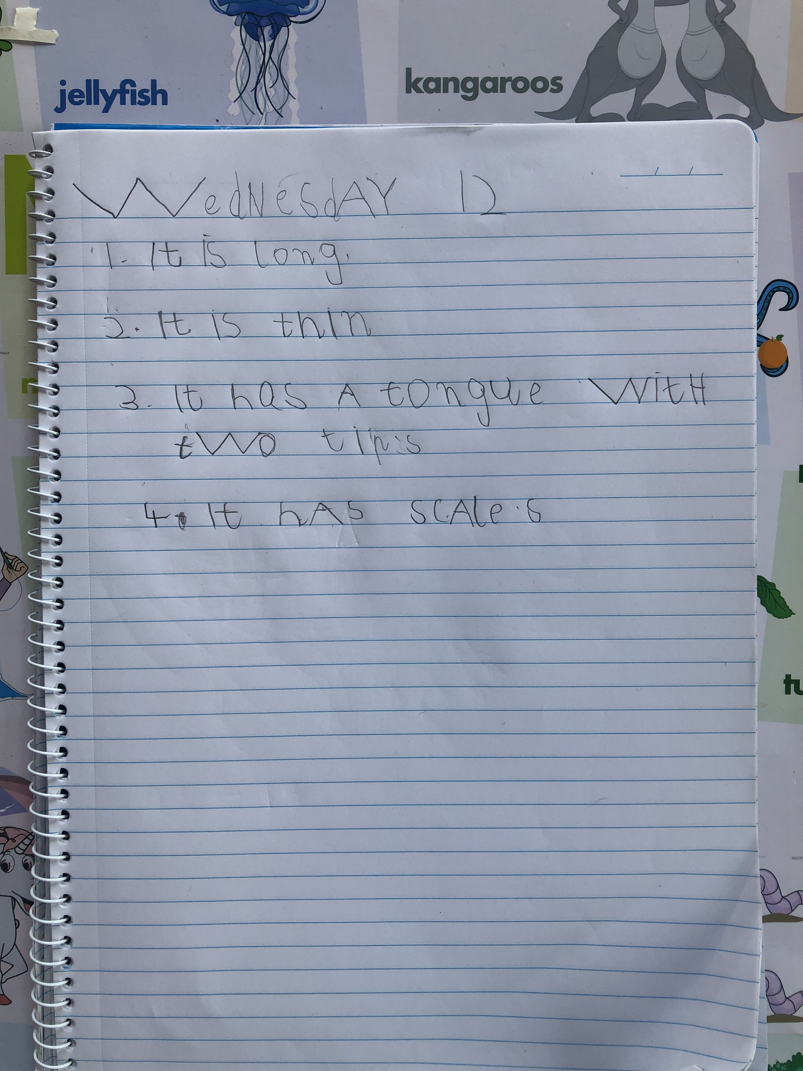
1. It is long
2. It is thin
3. It has a tongue with
two tips
4. It has scales

Slide 4
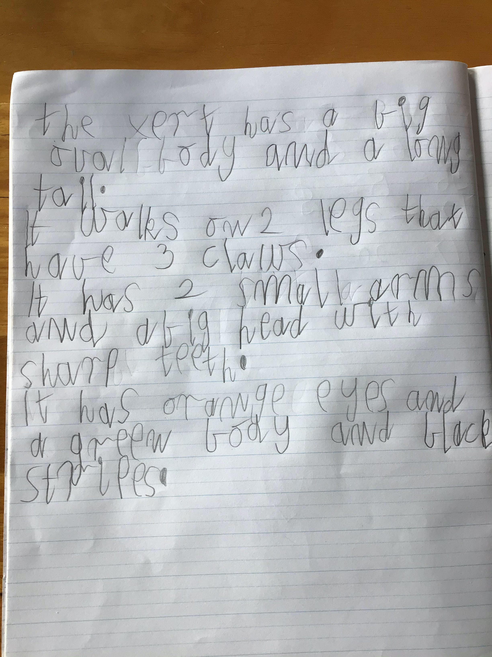
The xert has a big oval body and a long tail.
It walks on on 2 legs that have 3 claws.
It has 2 small arms and a big head with sharp teeth.
It has orange eyes and a green body and black stripes.

Slide 5
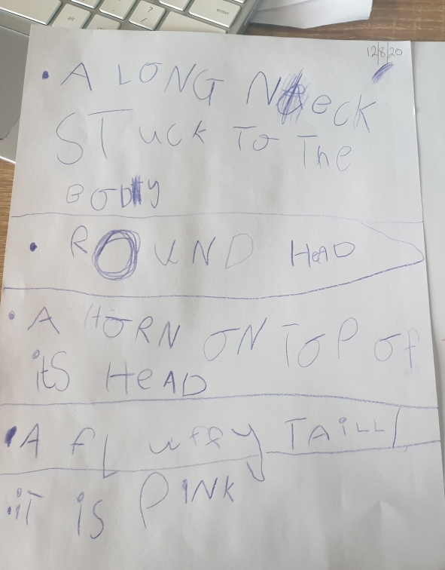
A long neck stuck to the body
Round head
A horn on top of its head
A fluffy tail
It is pink

Slide 6
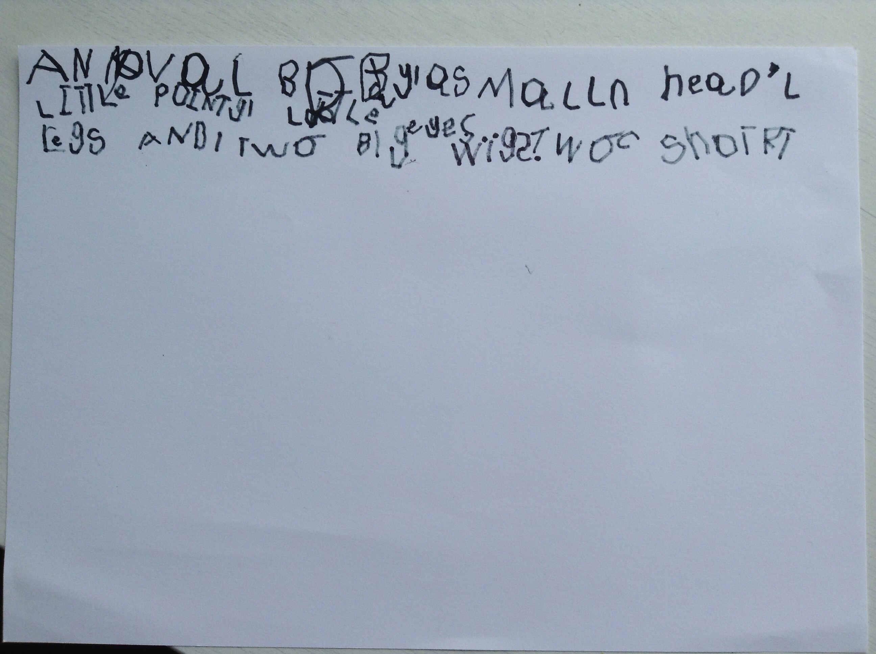
An oval body
A small head
Little pointy ears
Little eyes
Two short legs and two big wings

Slide 7
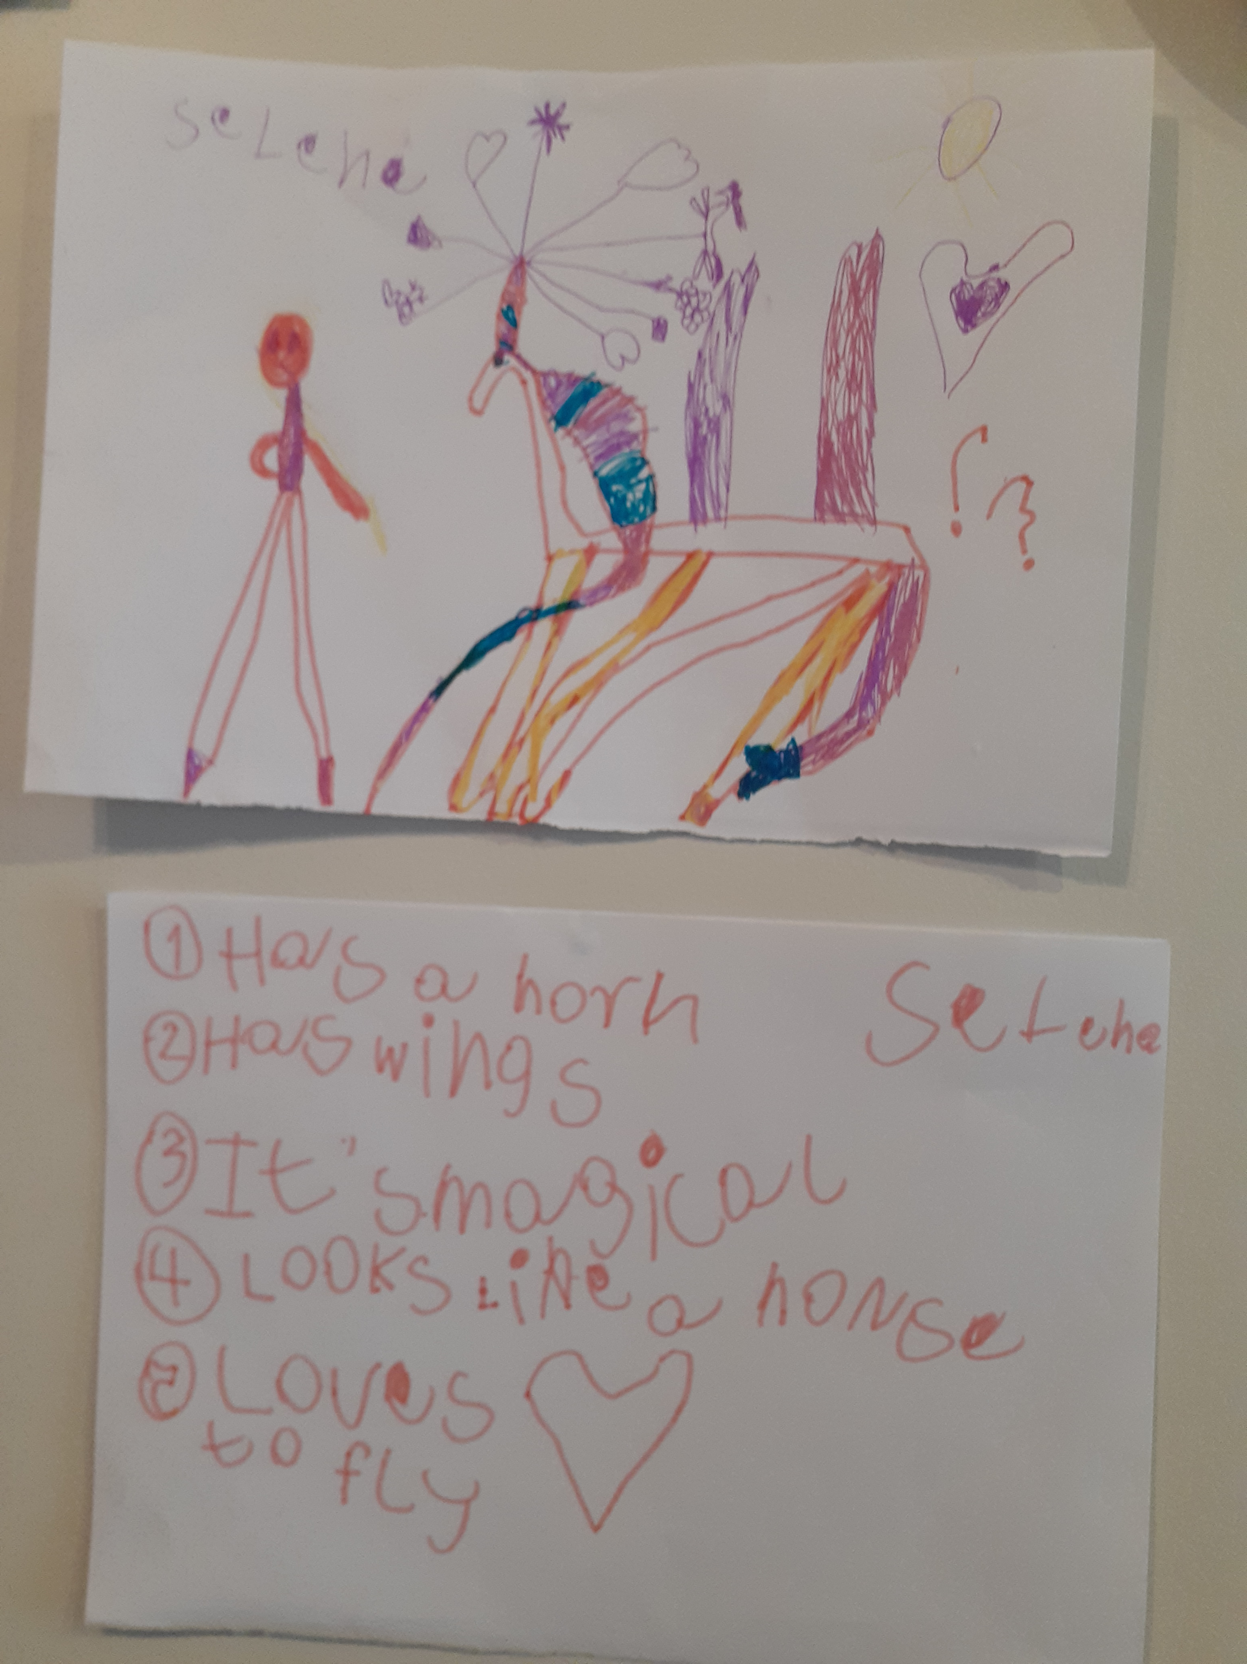
Has a horn
Has wings
It’s magical
Looks like a horse
Loves to fly

Slide 8
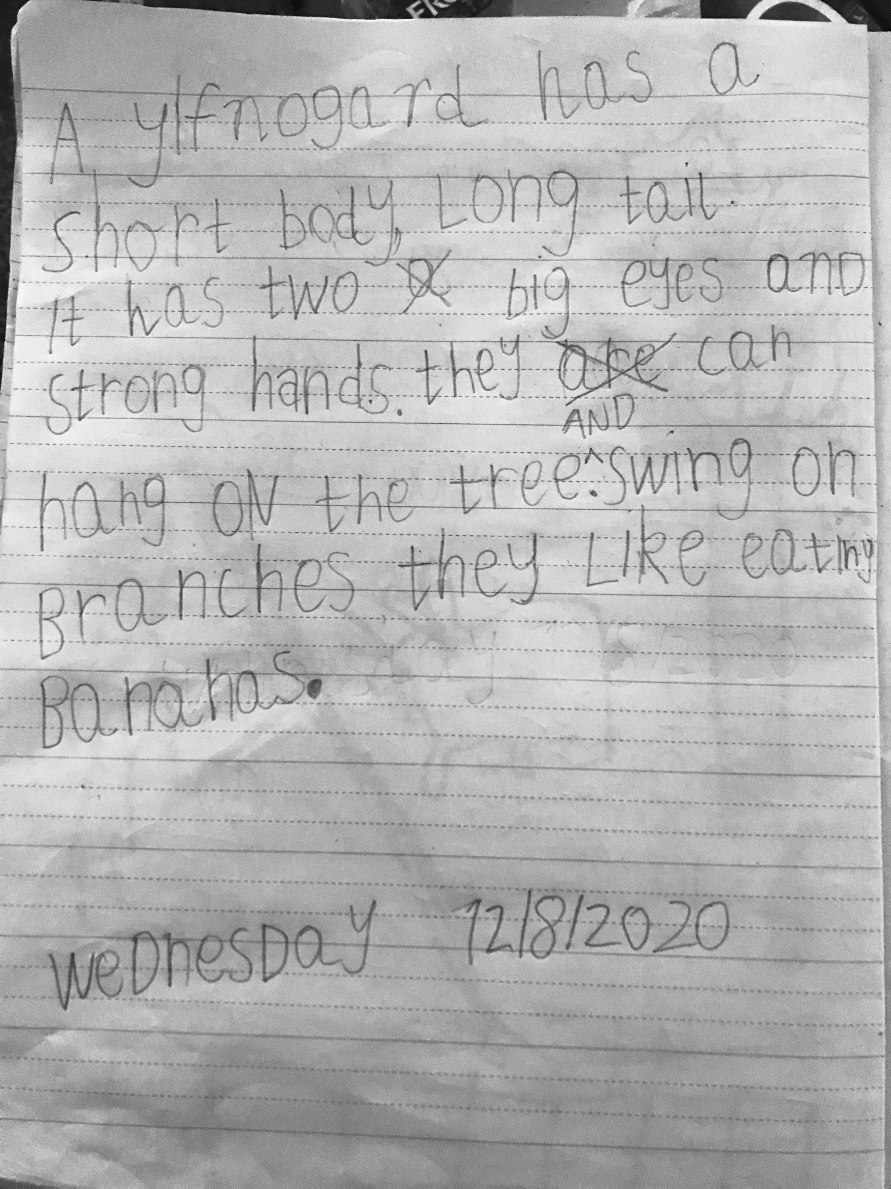
A ylfnogard has a short body, long tail.
It has two big eyes and strong hands.
They can hang on the tree and swing on branches.
They like eating bananas.

Slide 9
It has a tail. And it has hair. And it has 4 legs. And it has an oval body shaped body. And it has 2 eyes. And it has 1 nose. And it has 1 mouth.

Slide 10
Big eyes
Big wings
Purple and blue feathers
Claws

Slide 11
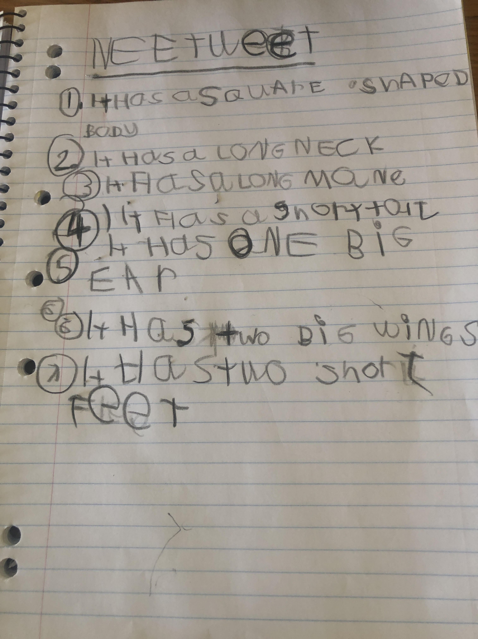
NEETWEET
Has a square shaped body
It has a long neck
It has a long mane
It has a short tail
It has one big ear
It has two big ears
It has two short feet

Slide 12
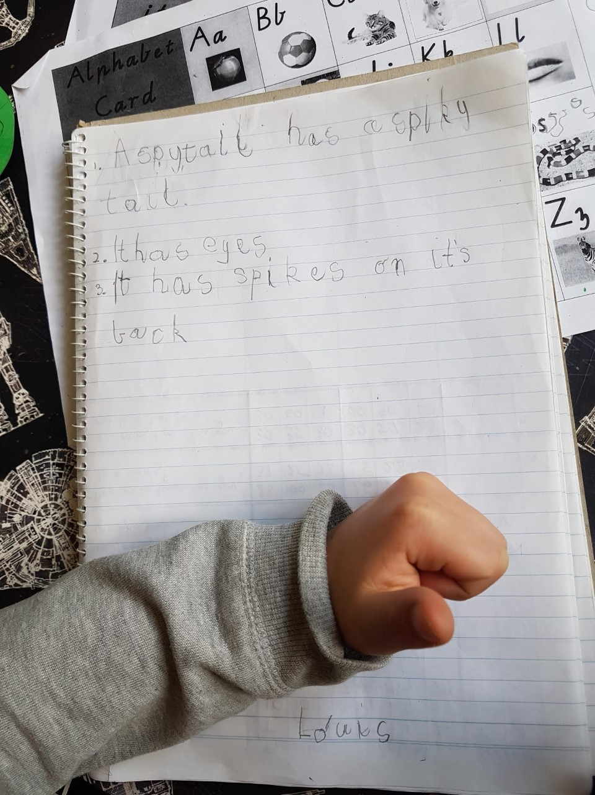
A spytail has a spiky tail.
It has eyes.
It has spikes on its back.

Slide 13
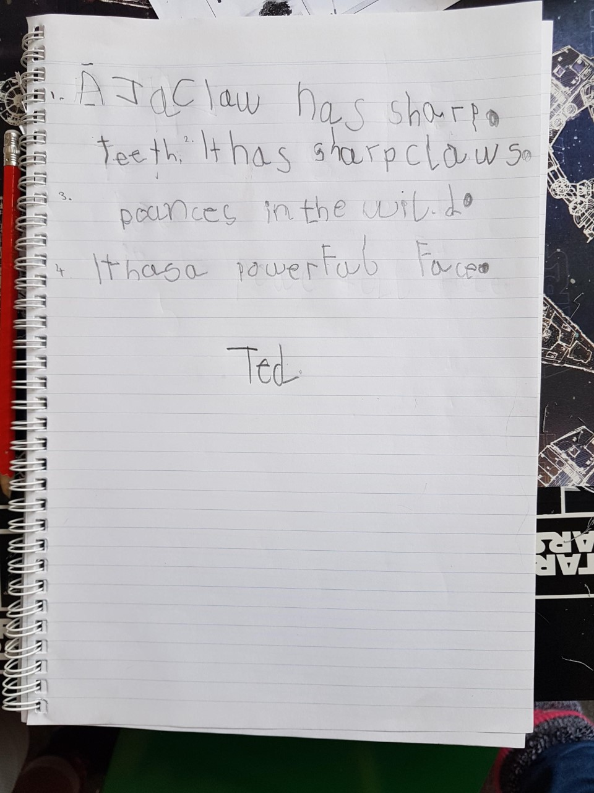
1. A jaclaw has sharp teeth.
2. It has sharp claws.
3. Pounces in the wild.
4. It has a powerful face.

